Slide 1
Hypercapnic Respiratory Failure
O₂ →
Research Program at Intermountain Health
Pulmonary
Circulation
Muscle
Brian W. Locke, MD MSCI
Assistant Professor of Research Shock Trauma ICU & Schmidt Chest Clinic Pulmonary & Critical Care, Intermountain Medical Center
COI: Equity in Mountain Biometrics (automated data harmonization) — unrelated to this work
← CO₂ buildup
adapted from Wasserman et al.
Research Leadership Team — Mar 2026
Confidential and property of Intermountain Health
Notes:
FORMATTED TALK — Slide 1 (Title / Introduction)
Hi, everyone. My name is Brian Locke. I'm going to talk for about ten minutes on my research program here at Intermountain.
In terms of jumping in — since we don't have a lot of time — I think I've met most folks on the call, but for those I haven't: I'm Brian. I joined Intermountain roughly two years ago. I have backgrounds in computer science and clinical investigation. I practice in the Shock Trauma ICU and also down in the Schmidt Chest Clinic, where I have a subspecialty clinic in chronic respiratory failure — so patients who need home ventilation, have obesity hypoventilation syndrome, or any other combination. Essentially, the population we're going to talk about today.
My research focuses primarily on trying to better capture data out of the health record to support research on hypercapnic respiratory failure, which right now primarily means describing the disease burden, costs, and care processes that are occurring. Although my hope is to build that up into a program that tests interventions to improve their care.
So, just to jump to our topic — the scale of the problem. Hypercapnic respiratory failure has a substantial health burden that actually doesn't receive much attention as an all-cause syndrome, and I'll talk about why I think it should. If we think about how often hypercapnic respiratory failure occurs, the best period prevalence estimates put it at somewhere around 150 cases per 100,000 people per year — and I think that's probably a bit of an underestimate. Just as a reference, that's probably about double the rate of decompensated cirrhosis, which is something we also take care of a lot in Shock Trauma. It carries substantial mortality — about 20% in the two months after. And about a quarter of patients are readmitted within 60 days, usually with recurrent hypercapnic respiratory failure.
If we look in Utah, we find evidence that there is quite substantial diagnostic burden. When we looked at the all-payer claims data, we see around 15,000 cases diagnosed by ICD code, which is a substantial undercount in Utah. More pertinent to us, in the Intermountain–Select Health co-insured population, there are about 1,000 cases per year in the Canyons region if you include blood gas criteria. And by that criterion, these admissions cost about $50,000 per index hospitalization.
So — can better healthcare delivery improve these outcomes? I think there's a big reason to suspect so. When we look at what currently happens with these patients, it's really only about a third — or a quarter, or one in five — who actually have preexisting diagnoses before they come into the hospital. In some ways it's similar to decompensated cirrhosis, in that it's not usually somebody who's never had lung disease. But it's a big problem because the clinical practice guidelines that recommend different strategies of care presume that the diagnosis has already been firmly established. When one of these patients comes into the hospital, it's not possible to get all the testing they would need for that diagnosis — for example, sleep testing has to occur as an outpatient.
If we look statewide at how many people who have an ICD code for hypercapnic respiratory failure go on to get the correct testing, we see only 15% get pulmonary function testing, 10% get sleep testing — very low. About a half get echocardiograms, so that's better. Part of the reason is that there's a transfer of care that has to happen between the inpatient teams and the correct specialist, and often the correct specialist isn't known. So when we think about what to do here, I think there's significant room for improvement.
I mentioned a couple of times that the way we identify patients matters a lot. This is prior work from our group, including Sam and Ithan, that was published in CHEST relatively recently. One of the key findings is that if you look through the literature at what methods people have used to identify patients with hypercapnic respiratory failure in health record data, the different strategies select non-overlapping people. The main reason is that the different diagnostic tests — arterial blood gases, venous blood gases — or whether you try to select an even narrower group based on whether they ultimately needed intervention — none of those have good sensitivity for the underlying condition in practice.
Companion work presented at a machine learning conference showed that you can use a variety of data elements from the health record — bicarbonate, risk factors, prior diagnoses — and do a decent job of identifying these people, or at least a more stable job.
So why does it matter? We really need a different workflow for how we manage these patients. On the clinical side of the research program, the clinic serves a dual purpose: it addresses a gap in how these patients are managed, but my goal would also be to use it to generate evidence. Right now, the Schmidt Chest Clinic is set up to care for some of these patients. We're identifying patients primarily by word of mouth and through the inpatient respiratory therapy teams. There's an AVAPS protocol that can lead to my clinic. The strategy is that the inpatient clinical teams identify patients, they talk with our pulmonary disease navigators — Megan Hepworth is the primary one — and then myself or Gabriel Norton, an APP in clinic, handle issues that occur in that peri-discharge period. We quarterback the immediate workup with the goal of saying: this care has traditionally been scattered, and there hasn't been clear ownership of, say, a patient who doesn't come to get the needed workup. Who's going to reach out to them? That hasn't been totally clear.
The research side is supported through the PCCM seed grant, and I've been using that for two parallel data streams. One I call AIM-High, which is a collaboration with Select Health. We've linked Intermountain and Select Health data, and we've looked back using those various case definitions I talked about earlier. Our goal is to characterize the economics — costs and expenditures — for this group and also do some risk prediction and stratification. Clearly, not all patients who have high CO₂ in the hospital are at comparable risk. I suspect there are patterns of both patient characteristics and health system characteristics that can stratify who's at highest risk — because those are the people we want to identify in practice so they can, for example, be referred into my clinic. We're cleaning the data right now and hopeful to have results in the next few months.
The second pipeline is the CO₂-PATH Cohort, which uses Utah Population Database data. We've gotten regulatory authorization for statewide linkage with both the Intermountain and University of Utah data. This will be a substantially bigger cohort but with less outcome resolution. Our main aim is to more deeply characterize the statewide burden of disease and what care people are currently getting. I actually have a meeting later today with the Utah Population Database to go through some data specifications. We're moving a bit slower than on the Select Health side, but moving forward.
These two research projects are in support of a K23 that I'm going to be resubmitting later this year. It submitted last year, right around the time all of the chaos from the administration transition came through. I talked to a program officer earlier this year who was actually quite enthusiastic about just resubmitting. The three aims are: a discharge risk stratification aim primarily built on the Select Health cohort; a post-discharge management variation characterization aimed at establishing what people are currently doing and what could be done; and then to pilot a small nudge — I think it'll most likely be nudging a subset of potentially eligible patients to come see me in clinic in a more randomized or risk-targeted fashion.
My hope from those objectives is to get more experience analyzing variation, akin to what Ethan and Elizabeth Monroe have been doing in sepsis, and then more embedded trial design and prospective study experience. The hope would be to build this up into a more definitive efficacy pragmatic trial.
Another parallel stream that may not go through the NIH — maybe a separate grant for a different funder — is that obesity is a major risk factor here, and most patients with hypercapnic respiratory failure already have an FD designation. So GLP-1 efficacy in this group is a major unanswered question, and I think that's another stream I'm looking into. My goal is to continue to develop as a technologist and methodologist in those spaces.
So with all of that, I'll end there and give thanks to the different groups that have supported this and the data team, some of whom I've mentioned and there are more. With that, I'd be happy to take any questions.
Feedback
Overall Impression: This is a strong, well-organized 10-minute research overview. You clearly communicate the clinical problem, your unique position to address it, and a credible roadmap from descriptive work → K23 → pragmatic trial. The audience (Research Leadership Team) should come away understanding both the significance and your trajectory. A few notes:
Strengths
Compelling problem framing. The cirrhosis comparison is an excellent anchor — it instantly conveys severity to an audience of clinical researchers. The cost figure ($50K/admission) and readmission rate (25% at 60 days) land well.
Clear research architecture. The two-pipeline structure (AIM-High with Select Health + CO₂-PATH with UPDB) is easy to follow and shows thoughtful study design with complementary strengths (depth vs. breadth).
Honest about the knowledge gap.Citing the non-overlapping case definitions and low diagnostic testing rates (15% PFTs, 10% sleep) is powerful evidence that the field needs your work.
Clinical-research integration. Framing the Schmidt Chest Clinic as both a clinical service and a research vehicle is smart for this audience.
Areas to Tighten
The opening runs long before the "hook." You spend roughly 90 seconds on introductions and background before you get to the scale of the problem. For a 10-minute talk, consider trimming the intro to ~30 seconds ("I'm Brian Locke, I joined two years ago, I practice in Shock Trauma and the Schmidt Chest Clinic in chronic respiratory failure") and getting to the 150/100K prevalence faster. The audience already received your title slide — trust it.
The diagnostic gap section meanders.You make the critical point — patients aren't getting tested — but then immediately pivot to the case definition problem. Consider separating these clearly: (a) "Patients aren't getting diagnosed or worked up" → data on low testing rates; (b) "And even in research, we can't agree on who these patients are" → the CHEST paper. Right now they blend together and dilute each other.
Verbal hedging dilutes authority.Phrases like "I think probably," "you know," "sort of," "a bit of" appear frequently. A few are natural and human — but in a 10-minute slot, they add up. The most impactful statements in your talk are the direct ones ("These admissions cost $50,000 per index hospitalization"). Try to match that directness more consistently, especially for your main claims.
The K23 aims need a punchier delivery. This is arguably the most important part for your audience, but it arrives when you're running low on time and the framing becomes somewhat list-like. Consider a brief setup sentence: "The K23 has three aims that build on each other: risk stratification, variation characterization, and a pilot nudge intervention." Then elaborate briefly on each rather than threading them into a single run-on thought.
The GLP-1 mention feels tacked on.It's an exciting idea but comes as a tangent right before you close. Either give it a real 30-second setup earlier (perhaps when discussing obesity as a risk factor) or save it for Q&A. Dropping it in the last minute without context may confuse rather than excite.
The close is too soft. "I'll sort of end there" undersells a strong talk. Consider a one-sentence summary statement: "In summary, hypercapnic respiratory failure is common, costly, and undertreated — and we're building the data infrastructure and clinical workflows to change that." Then thank people and open for questions.
Time Management
This transcription runs closer to 12–13 minutes of spoken delivery. If you have a hard 10-minute cap, the easiest cuts are: (a) shorten the personal introduction, (b) condense the case-definition discussion to one sentence + one visual reference, and (c) cut the GLP-1 aside to Q&A.

Slide 2

ABOUT
Brian W. Locke, MD MSCI
Assistant Professor of Research · Pulmonary & Critical Care · Intermountain Medical Center
MD (Colorado) · MSCI Clinical Investigation (Utah) · BS Computer Science (Colorado)
Shock Trauma ICU + Schmidt Chest Clinic (chronic respiratory failure, HMV, OHS)
Core faculty, U of Utah PCCM Fellowship · Medical Machine Intelligence Lab
Research focus
EHR phenotyping & diagnostic modeling for hypercapnic respiratory failure
Building toward embedded pragmatic trials at Intermountain
Dedicated chronic respiratory failure subspecialist for Intermountain

Slide 3
The Scale of the Problem
A national burden, a local reality
~200/100K
14,876
~1,000 per year
GLOBALLY
IN UTAH
IH / SELECTHEALTH
person-years period prevalence
Comparable to decompensated cirrhosis; 20% 2-month mortality
cases by ICD code (2015–2019)
ICD only — does not capture blood-gas-identified cases
Canyons region, coinsured; ICD + blood gas
$50K per index hospitalization
Spending elevated months before admission — modifiable window
Chung et al. AJRCCM; Locke et al. ATS 2025; Locke et al. ATS 2026 | UPDB, TriNetX, IH/SelectHealth
Can health services research and better care organization improve these outcomes? →
Notes:
grant-making schema:
How big is the problem
How solvable is it?
How many people are working to solve it? (ie if we spend a bit more resources on this problem, will it make a difference?)

Slide 4
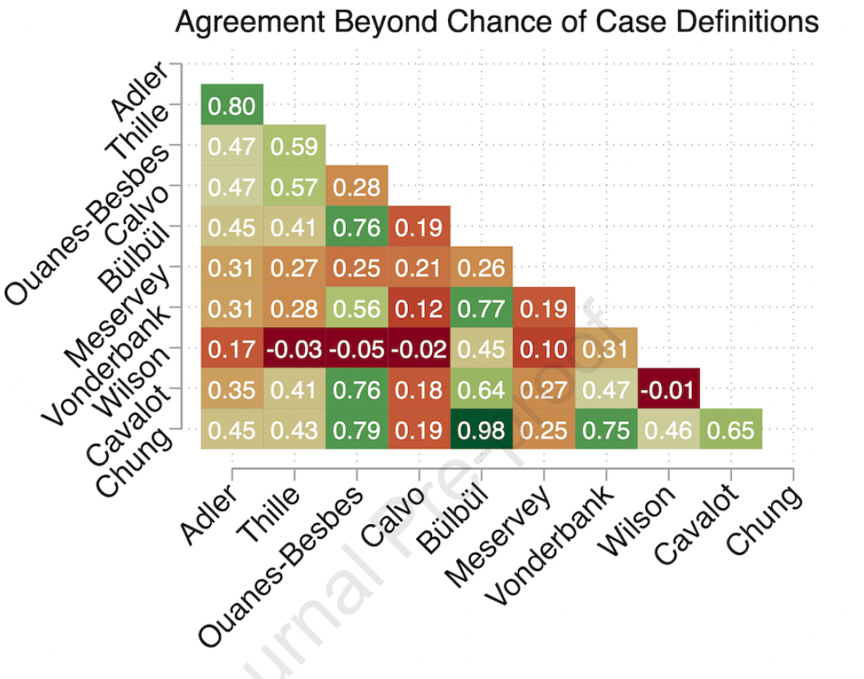
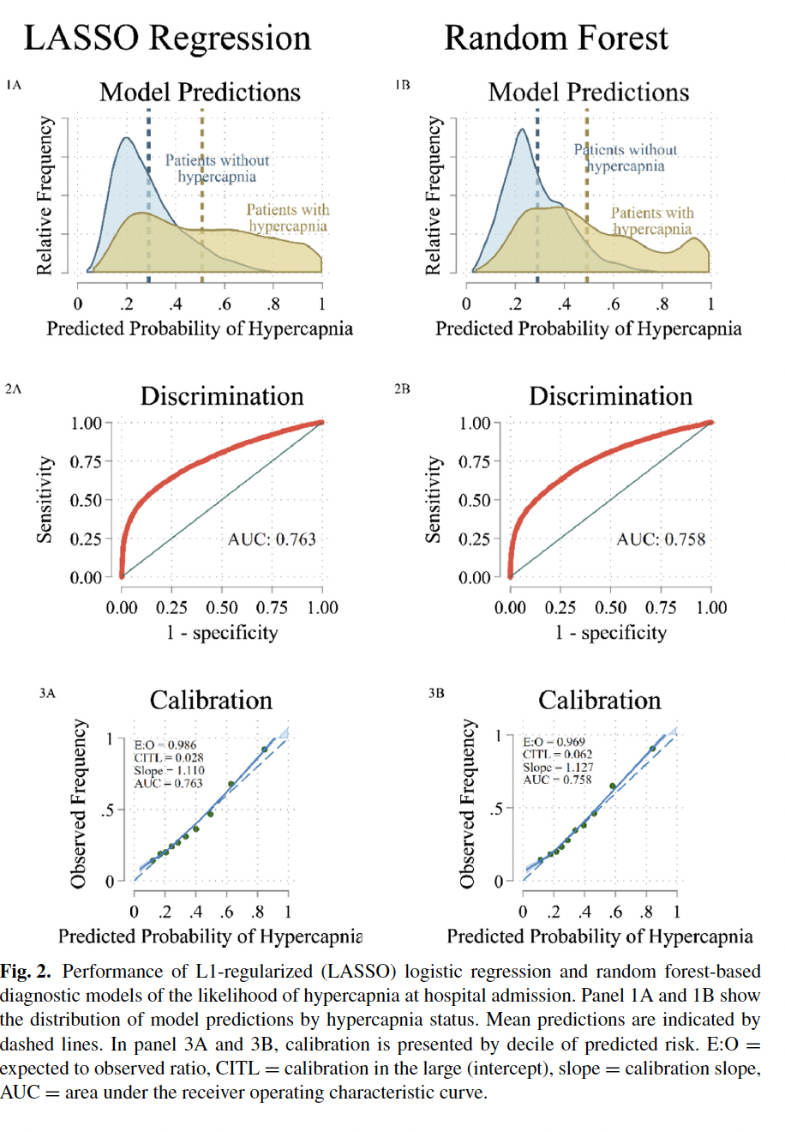
OUR PRIOR WORK
The Consistency of Hypercapnic Respiratory Failure Case Definitions in Electronic Health Record Data
Locke BW, Richards WW, Gouripeddi R, Brown JP, Finkelstein J, Sundar KM, Peltan ID, Brown SM
Key Finding
Published case definitions for hypercapnic respiratory failure identify meaningfully different cohorts, limiting literature synthesis and agreement on who should be studied or counted
Agreement Between Definitions
Companion: Diagnostic Model
Pairwise Cohen's κ across six definitions — agreement ranges from slight to moderate
Random forest predictions, ROC, & calibration for ML identification of unrecognized hypercapnia (Locke et al. LNAI 2024)
So what are we doing about it? A new clinic + funded research to quantify practice patterns at Intermountain →

Slide 5
A Promising Problem to Solve
Solvable and overlooked
!
Overlooked: A paradigm gap
↑
Solvable: Missing the window
Patients arrive undifferentiated — guidelines can't help.
Only 31% PFTs, 21% sleep testing in 5 yrs pre-diagnosis
CPGs address single diseases — not undifferentiated patients
These patients fall outside existing evidence
Low testing implies low management — patients are being missed.
~15% PFTs, ~10% sleep testing in 1 yr after
Discharge handoffs are complicated and error-prone
Many who might benefit are simply never evaluated
Utah (n = 14,876): TTE ~50–63% vs. PFT/sleep ~10–31% — gap is specific to outpatient workup
Locke et al., ATS 2025 — Utah APCD + Health Facilities Database, 2015–2019
Notes:
SO WHAT — THE EVIDENCE GAP
Current guidelines assume a known etiology. Most patients arrive without one. The result: low rates of diagnostic workup, fragmented post-discharge care, and no systematic framework for identifying who benefits from early intervention.

Slide 6
Chronic Respiratory Failure Clinic
A new clinic to simplify care and generate evidence
Schmidt Chest Clinic at IMED | New subspecialty clinic | Pulmonary disease navigators + dedicated providers
Identify
Navigate
Evaluate & Manage
Word of mouth and inpatient RT today; criteria-based as evidence develops
PDNs, Dr. Locke, and G. Norton handle equipment, triage, and referrals
Structured workup with a clear point of contact for post-discharge issues
Consolidates scattered care: including post-discharge device qualification that currently has no clear ownership pathway
Payer-linked data lets us measure whether it works and what it costs

Slide 7
PCCM Seed Grant
Two research programs
FUND-Hypercapnia • 2024–2027
AIM-HIGH
CO₂-PATH
AI for Modifiable Health Indicators in Groups with High Needs
Post-Acute Trajectories of Hypercapnia
Data: IH + Select Health linked clinical and claims records
~7,000 cases by ABG/VBG/ICD (2016–2024)
Goals: Risk prediction, economics, ML phenotyping
30-day readmission, 1-yr mortality, cost
High-risk phenotypes for targeted intervention
Status: Data cleaning underway; IH–SH linkage being escalated
Data: Statewide UPDB cohort linking IH + UHealth EDWs
~100K patients across all Utah hospitals
Goals: Post-discharge patterns across facilities
Diagnostic testing rates and facility-level variation
Status: Regulatory authorization complete; data acquisition underway
DATA CLEANING • LINKAGE IN PROGRESS
IRB APPROVED • BEGINNING DATA ACQUISITION
Both programs build toward NHLBI K23 career development award

Slide 8
LOOKING AHEAD
Research trajectory
Now (through 2026)
K23 (2026–2031)
Building toward
AIM-HIGH: risk prediction & ML phenotyping (IH–SelectHealth data)
CO₂-PATH: post-discharge trajectories (UPDB)
Continued TriNetX prototyping
IMED clinic as intervention & enrollment platform
K23 resubmission preparation
Research aims
Discharge risk stratification
Post-discharge management variation
Pilot embedded trial
Learning objectives
Multi-source outcomes ascertainment
Practice variation analysis
Embedded trial design & execution
Pragmatic trials optimizing post-discharge care
Scalable interventions: referral pathways, workup bundles, tele-pulmonary
GLP-1RA/metabolic therapies: ~60% have indication; effectiveness unknown (non-NIH funding)
Technologist & methodologist advancing care-transition best practices

Slide 9




ACKNOWLEDGEMENTS
Thank you — Questions?
Funding & Data
Team & Supporters
PCCM Seed Grant (FUND-Hypercapnia)
ATS ASPIRE Fellowship
NIH/NHLBI T32 | HCI P30
Data
Utah Population Database (UPDB)
IH – Select Health Claims Linkage
Intermountain Health
I. Peltan, MD MSc • S. Brown, MD MSc • H. Frost, MD PhD • N. Green
Select Health
R. Fowers, PhD • D. Hedges, PhD
University of Utah / RGE
R. Gouripeddi, MBBS MSc • M. Madsen
B. Jones, MD MSc • D. Anderson, MD • M. Gibson
UC Davis — K. Sundar, MD
brian.locke@imail.org | Epic: Brian Locke | Re: referral & research partnerships

